Slide 1
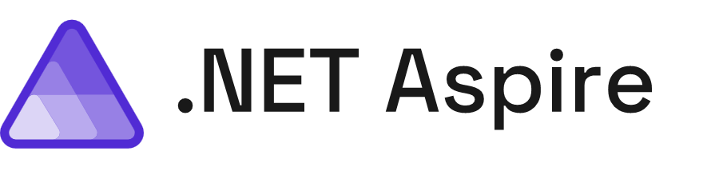

Introduction à
Nom du présentateur
Nom de l'entreprise
/@Account
/@Account

Slide 2
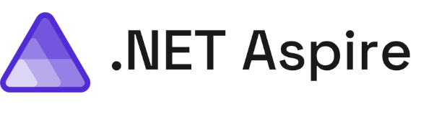
Toutes les ressources d'apprentissage
aka.ms/letslearn/dotnet/aspire
GitHub de l’atelier (workshop)
github.com/dotnet-presentations/letslearn-dotnet-aspire
Notes:
There are tons of great .NET Aspire learning resources available and we have a single link to guide you through our learning journey including a brand new training path on Microsoft Learn.
Today we will be going through a workshop from start to finish available on GitHub so you can follow along at home. You can go directly to this github repository or click on it from the main learning resources link, it is at the top.

Slide 3
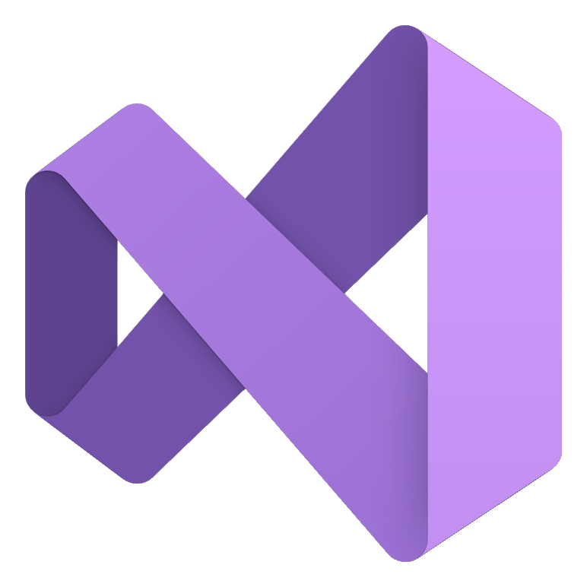

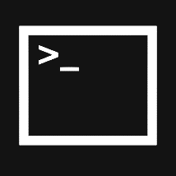






Construisez de tout avec une plateforme unifiée
.NET
Cloud
Web
Desktop
Mobile
Gaming
IoT
AI
+
+
Visual Studio
Visual Studio Code
CLI
Linux
NuGet
GitHub
Components, tools, library vendors
Windows
macOS
Outils
Système d'exploitation
Écosystème
Notes:
.NET’s goal is to be a unified development platform that developers love and businesses trust.
It enables developers to build any kind of application with best-in-class runtime, programming languages, development tools, and a vast ecosystem that is powered by amazing developers around the world.”
You can any type of application across web, mobile, desktop, cloud, and more while infusing them with AI and building them across any operating system and a wide range of tools and a great command line.

Slide 4
Toutes applications a besoin
Observabilité
Résilience
Évolutivité
Gestion
Notes:
No matter what type of application you're building every single application needs to be observable to get deep insights while you're debugging your application and while it's out into production. Additionally, they need to be resilient which means that no matter what the Internet connectivity is or the environment they need to be always up and running not only on the front end but also on the back end. They have to be scalable your application today much of serve a few 100 people but what happens when it serves 10s of thousands or hundreds of thousands of users. And finally, as a developer we want to be able to easily manage our application and easily deploy them so we can continuously and rapidly iterate on our apps.

Slide 5
.NET 8 inclut
Observabilité
Résilience
Évolutivité
Gestion
Built in metrics with dimensions
Nouveaux packages de résilience basés sur Polly
AOT (densité accrue)
Prise en charge de la rotation automatique des certificats dans Kestrel
Intégration ID pour les métriques
Reconnexion avec état SignalR
Performance
Meilleure prise en charge de la journalisation (plus rapide, peut objecter à la sérialisation)
Chiseled Ubuntu
Enrichissement
Rédaction
Test avec faux pour la journalisation et les métriques
Notes:
Now inside of .NET you have the ability to not only build these applications but integrate into all of these different parts and in .NET eight the team added even more goodness across all of these different key areas for developers. This means at your fingertips you can easily integrate different NuGet packages and services from the frameworks into your applications to make them more observable resilient scalable and manageable in the long run.

Slide 6
Ce n'est toujours pas facile🙁
Complexe
Débuter
Choix
Chemin tracé
Notes:
And even though a lot of this is included directly into the SDK and additional packages, it doesn't mean it's necessarily easy because applications as we build them out and get more complex as they go So what this means is that as developers we have a lot of choices to pick we don't necessarily always have the best knowledge of where exactly to get started because of those choice options and as a .NET developer wouldn't it just be great if we had a paved path or a recommended path to do this with our applications.

Slide 7

Une pile prête pour le cloud pour créer des applications distribuées observables, prêtes pour la production
Notes:
And that is why the team built .NET Aspire it's a cloud ready stack for building observable, production ready, distributed applications and to help us be more productive as developers when we're developing and deploying our applications.

Slide 8
Qu'est-ce que cela signifie? C'est pour qui? Dois-je l'utiliser ?
Notes:
But what does this actually mean right those are some fancy words is this for me should I use? Do I have to convert my application? should every application use it?
The short answer is yes .NET Aspire is for every application no matter how big or how small let me explain.

Slide 9
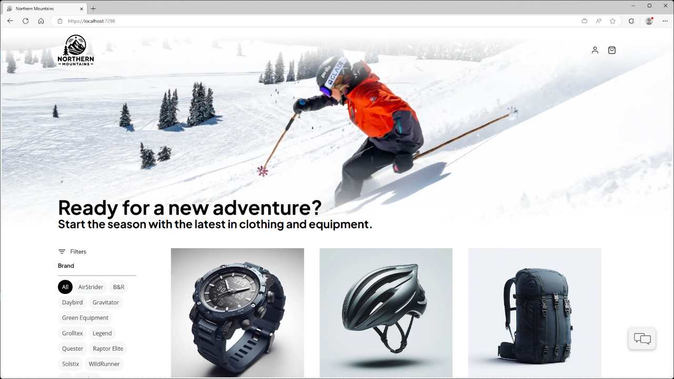
Notes:
Let's say you're building a website, here for example is a sports website that many of us maybe have built or at least browsed online now we think to ourselves what goes into building this application and you might have a small team or you might have a big team that's building this type of app.

Slide 10

Services Cloud
Web App
Blazor App
Data Source
Notes:
Let’s start at the very beginner of how I would build this app. I would spin up a Blazor web app with some data. Maybe it is hardcoded or in a json file, or even maybe a small SQLite database. With just a single web app there is plenty that .NET Aspire can help me with we will get into.

Slide 11

Services Cloud
Web App
Blazor App
Backend API
PostgreSQL
Identity
Catalog
Order
Basket
Payment
Notes:
.NET Aspire starts to shine as your application grows. A common scenario for developers are building a backend for their frontend side by side. The backend usually talks to a database and has multiple APIs that the web app can talk to. There are several features of .NET Aspire that this type of application can take advantage of.

Slide 12



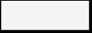

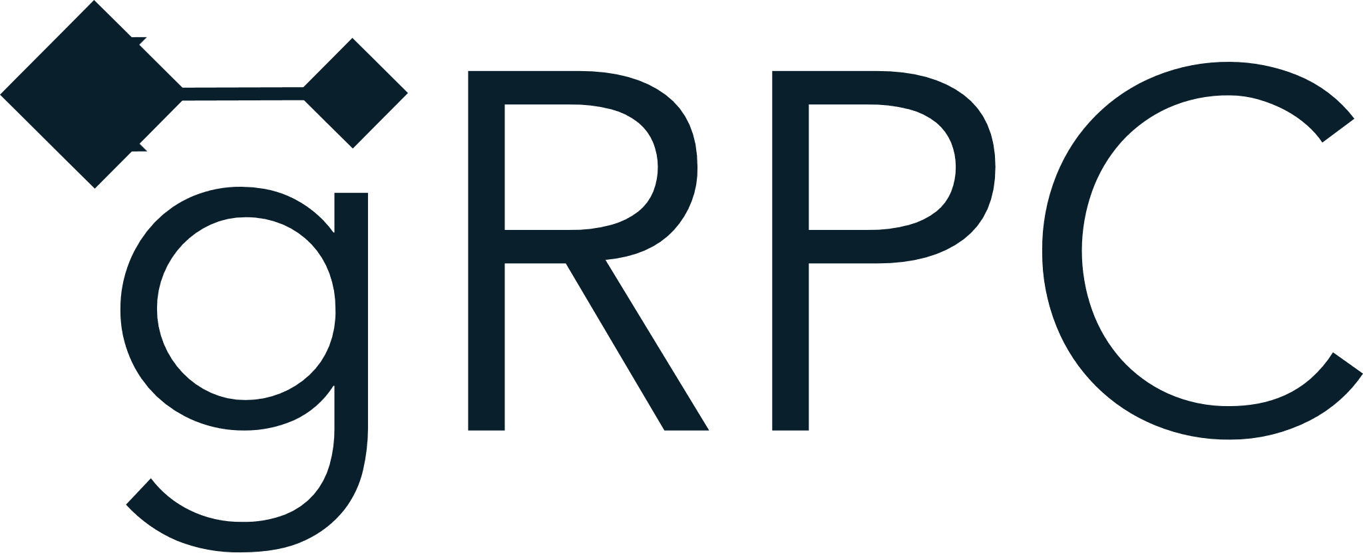
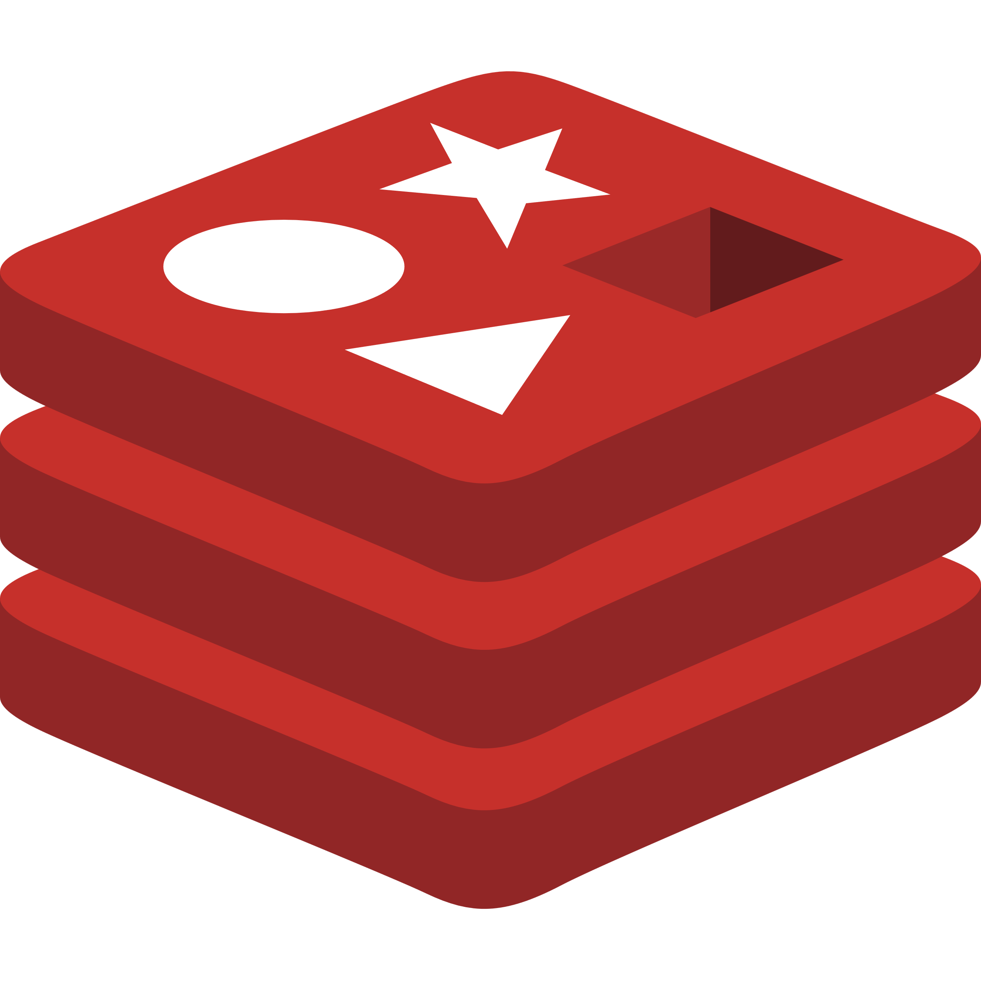
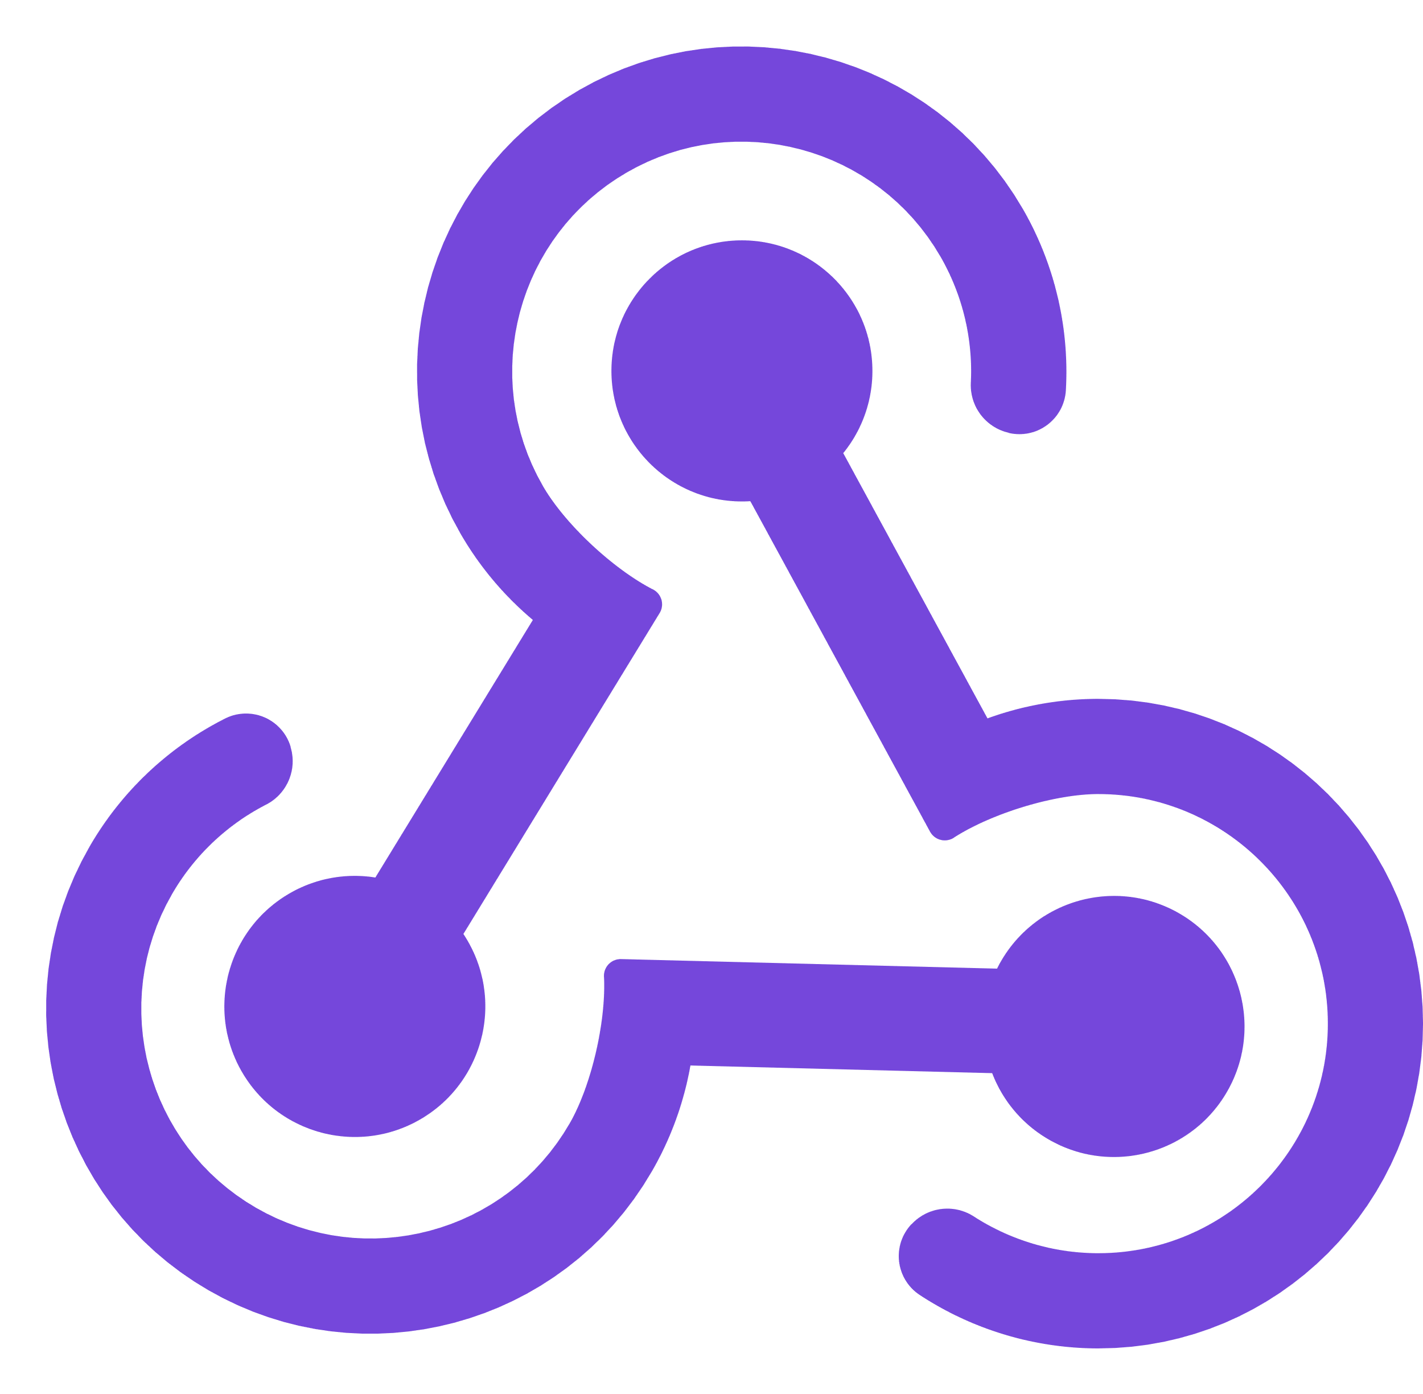

Services Cloud
Apps Clientes
Identity Service
Mobile BFF
Identity API
PostgreSQL
Mobile App
OpenAI
Mobile API
Catalog Service
Catalog API
PostgreSQL
Order Service
Ordering API
Web App
Ordering API
Order Processor
PostgreSQL
Event Bus
Browser
Blazor App
Basket Service
Basket API
Redis
Payment Service
Payment Processor
Admin Services
Webhook Client
Webhooks Service
Observability
Webhooks API
PostgreSQL
Notes:
At some point you may start to build out a fully distributed cloud-native architected project with lots of different dependences.
In each these scenarios whether your application is small as a single API with the front end and a back-end or a full cloud native distributed application .NET Aspire is a great use case for you.

Slide 13
Fonctionne avec TOUTES les applications et évolue avec vous !
Notes:
What I like to say is every single application should have .NET Aspire added to it and I'm going to show and tell you why and by the end of this presentation and this demo as we follow along you're going to be wow at how developer productivity is boosted and I can get deep insights into my application

Slide 14
Une pile prête pour le cloud pour créer des applications distribuées observables, prêtes pour la production
Paramètres par défaut intelligents
Tableau de bord du développeur
Orchestration
Découverte de services
Composantes
Déploiement
Notes:
So what's in .NET Aspire? There's a series of different features that help developers be more productive, build better observable production ready distributed applications, and ease the deployment in many scenarios for us. We're going to take a look at every single one of these different features from start to finish and integrate them into our application. Now a lot of people start with the developer dashboard because it's the fancy shiny thing that ships directly with .NET Aspire but we're going to start in a different area first which I think is one of the areas and features that every single application should integrate into our application today

Slide 15
DÉMO
Présentation pas à pas de l'application initiale
Clone: https://github.com/dotnet-presentations/letslearn-dotnet-aspire
Notes:
Let’s take a look at the project we will be “Aspireify” today. This application is a weather hub that uses the United States national weather service API with a nice Blazor UI that allows you to select a weather station.
First, let’s clone the repo where you will find the source code for the app, these slides, and full walkthrough guides that you can follow along.
NOTE: Open up this github repo and do a walkthrough of the necessary setup steps

Slide 16
Une pile prête pour le cloud pour créer des applications distribuées observables, prêtes pour la production
Paramètres par défaut intelligents
Tableau de bord du développeur
Orchestration
Découverte de services
Composantes
Déploiement
Notes:
So what's in .NET Aspire? There's a series of different features that help developers be more productive, build better observable production ready distributed applications, and ease the deployment in many scenarios for us. We're going to take a look at every single one of these different features from start to finish and integrate them into our application. Now a lot of people start with the developer dashboard because it's the fancy shiny thing that ships directly with .NET Aspire but we're going to start in a different area first which I think is one of the areas and features that every single application should integrate into our application today

Slide 17
.NET Aspire paramètres par défaut (Service Defaults)
Observabilité
Résilience
Contrôles de santé
Notes:
Well, there are several things that every single type of application needs, and they're integrated directly into the .NET SDK or packages. If you want to go ahead and configure all of these yourselves you totally can and many applications today might add one or two of these different areas but with smart defaults with one single project added into your solution, you will be able to integrate in a set of defaults are recommended by the asp.NET core team into your applications let's see what that means.

Slide 18
Observability
public static IHostApplicationBuilder ConfigureOpenTelemetry(this IHostApplicationBuilder builder)
{
builder.Logging.AddOpenTelemetry(logging =>
{
logging.IncludeFormattedMessage = true;
logging.IncludeScopes = true;
});
builder.Services.AddOpenTelemetry()
.WithMetrics(metrics =>
{
metrics.AddAspNetCoreInstrumentation()
.AddHttpClientInstrumentation()
.AddRuntimeInstrumentation();
})
.WithTracing(tracing =>
{
tracing.AddAspNetCoreInstrumentation()
.AddHttpClientInstrumentation();
});
builder.AddOpenTelemetryExporters();
return builder;
}
Notes:
First is observability, OpenTelemetry is an open-source standard that is becoming the de facto way of getting deep metrics stack traces and insights into your application. With ASP.NET Core, OpenTelemetry is deeply integrated into the built in logging service and metrics and tracing services that are provided. It was just a few lines of code, and not only will the service defaults automatically configure this but they'll also enable you to set up exporters so you can publish that data in other places.

Slide 19
Observabilité
private static IHostApplicationBuilder AddOpenTelemetryExporters(this IHostApplicationBuilder builder)
{
var otlpEndpoint = builder.Configuration["OTEL_EXPORTER_OTLP_ENDPOINT"];
var useOtlpExporter = !string.IsNullOrWhiteSpace(otlpEndpoint);
if (useOtlpExporter)
{
builder.Services.AddOpenTelemetry().UseOtlpExporter();
}
// Uncomment the following lines to enable the Azure Monitor exporter
//if (!string.IsNullOrEmpty(builder.Configuration["APPINSIGHTS_CONNECTION"]))
//{
// builder.Services.AddOpenTelemetry()
// .UseAzureMonitor();
//}
return builder;
}
Notes:
These exporters directly enable you to export them to several different services out-of-the-box they will configure the gRPC exporter which is what the dashboard will use later to visualize which we'll talk about and see in a little bit. You can also configure it to use command line or other services such as Azure Monitor to see your telemetry in production. What's great about this is with just a few lines of code from these defaults you will automatically be ready to go with some of the best metrics and telemetry in just a few seconds here

Slide 20
Résilience
builder.Services.ConfigureHttpClientDefaults(http =>
{
// Turn on resilience by default
http.AddStandardResilienceHandler();
});
Notes:
When we think about our applications and having spotty Internet connections, we want our applications to be able to automatically retry for example or be able to pick up lost connections and with standard resiliency turnout by default your applications will be able to do just that. now of course these are the recommended defaults, but you can always tweak them to your exact needs.

Slide 21
Contrôles de santé
public static IHostApplicationBuilder AddDefaultHealthChecks(this IHostApplicationBuilder builder)
{
builder.Services.AddHealthChecks()
// Add a default liveness check to ensure app is responsive
.AddCheck("self", () => HealthCheckResult.Healthy(), ["live"]);
return builder;
}
public static WebApplication MapDefaultEndpoints(this WebApplication app)
{
if (app.Environment.IsDevelopment())
{
app.MapHealthChecks("/health");
app.MapHealthChecks("/alive", new HealthCheckOptions
{
Predicate = r => r.Tags.Contains("live")
});
}
return app;
}
Notes:
And finally, our health checks.
With just a few simple lines of code automatically the service defaults will configure your application with several health checks that you can extend with your very own health checks and additionally a few endpoints that you can set up for automation to make sure your applications are running in production. Now these specific service defaults will get extended in the future as we start to integrate additional features into our application, so these are our set of defaults for the base applications they enable further integration as we start to build out and integrate .NET Aspire and components into our application later.

Slide 22
DÉMO
.NET Aspire - Paramètres par défaut intelligents
Notes:
But now let's first take an application and add service defaults and configure it in an application that has a back end and a front end and see what we get.

Slide 23
Q&R
.NET Aspire - Paramètres par défaut intelligents
Notes:
But now let's first take an application and add service defaults and configure it in an application that has a back end and a front end and see what we get.

Slide 24
Une pile prête pour le cloud pour créer des applications distribuées observables, prêtes pour la production
Paramètres par défaut intelligents
Tableau de bord du développeur
Orchestration
Découverte de services
Composantes
Déploiement
Notes:
So what's in .NET Aspire? There's a series of different features that help developers be more productive, build better observable production ready distributed applications, and ease the deployment in many scenarios for us. We're going to take a look at every single one of these different features from start to finish and integrate them into our application. Now a lot of people start with the developer dashboard because it's the fancy shiny thing that ships directly with .NET Aspire but we're going to start in a different area first which I think is one of the areas and features that every single application should integrate into our application today

Slide 25
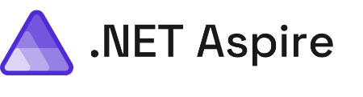
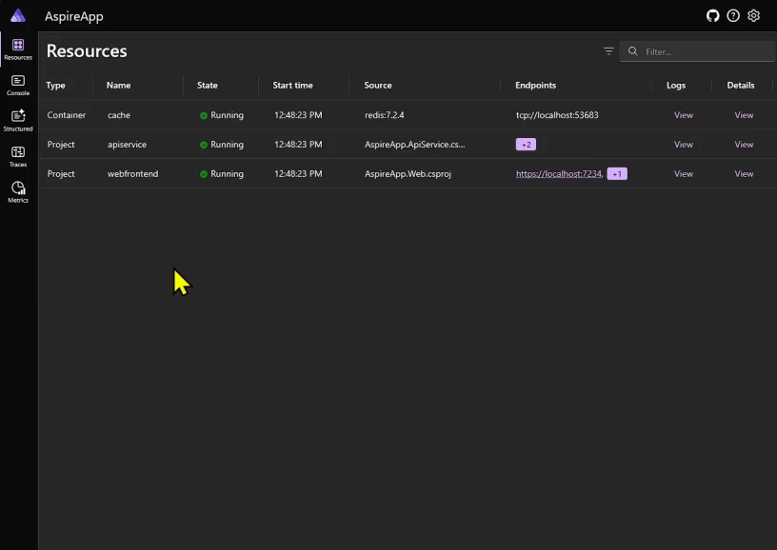
Tableau de bord du développeur
Journaux structurés
Métriques
Traces distribuées
Dépendances
Notes:
And that is where the developer dashboard comes in the developer dashboard for .NET Aspire gives you a one stop shop for an entire overview of your application including see all of your projects and dependencies running and giving you deep visualization of all of that OpenTelemetry data all coming in via the gRPC exporter. The dashboard is amazing because it's built 100% open source with .NET, Blazor, and FluentUI.

Slide 26
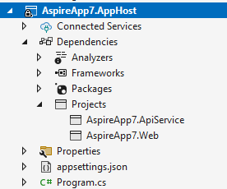
Intégration au Tableau de bord du développeur
Autonome
.NET Aspire App Host
docker run --rm -it -p 18888:18888 -p 4317:18889 -d --name aspire-dashboard mcr.microsoft.com/dotnet/aspire-dashboard:8.0.0
docker run --rm -it `
-p 18888:18888 `
-p 4317:18889 -d `
--name aspire-dashboard `
mcr.microsoft.com/dotnet/aspire-dashboard:8.0.0
Notes:
The .NET Aspire dashboard can be run multiple ways. It is available as a standalone container that you can run locally on your machine. This means the Dashboard can be used and deployed internally, for development deployments, or even production.
Most developers will get their first glance by using the .NET Aspire App Host project that will automatically orchestrate your projects and dependencies to launch and will open the dashboard automatically. Let’s talk about what that looks like.

Slide 27
Une pile prête pour le cloud pour créer des applications distribuées observables, prêtes pour la production
Paramètres par défaut intelligents
Tableau de bord du développeur
Orchestration
Découverte de services
Composantes
Déploiement
Notes:
As I mentioned, orchestration is one of the main feature of .NET Aspire. But what does that look like in practice?

Slide 28
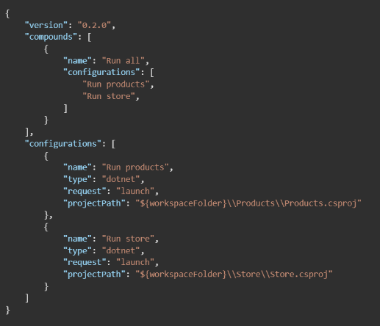
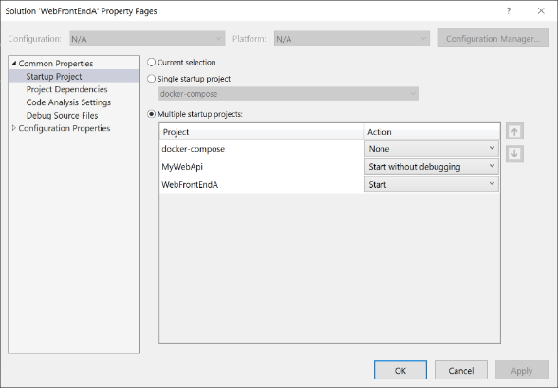
Avant
Notes:
So currently today and as you just saw if we wanted to run multiple services all at the same time and debug them we're going to have to run multiple commands or configure VS Code or Visual Studio to set up multiple startup projects. Additionally, if we have other dependencies such as this case maybe a database or another container, we're going to also have to spin them up automatically.

Slide 29
Orchestration
var builder = DistributedApplication.CreateBuilder(args);
builder.AddProject<Projects.ApiService>("apiservice");
builder.AddProject<Projects.Web>("webfrontend");
builder.Build().Run();
Notes:
This is where the .NET Aspire App Host and orchestration come into play. We add a new project to our application which is called the App Host and it is a distributed application that enables us to add project dependencies and orchestrate if you will a single file that tells the .NET Aspire App Host what to start up and what dependencies are required. In this case we can see that I have a distributed application with two different projects and API service and a web front end at this case I haven't orchestrated or done anything about dependencies or anything I'm just saying hey please start up my application which are these two services that live independently.

Slide 30
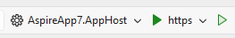
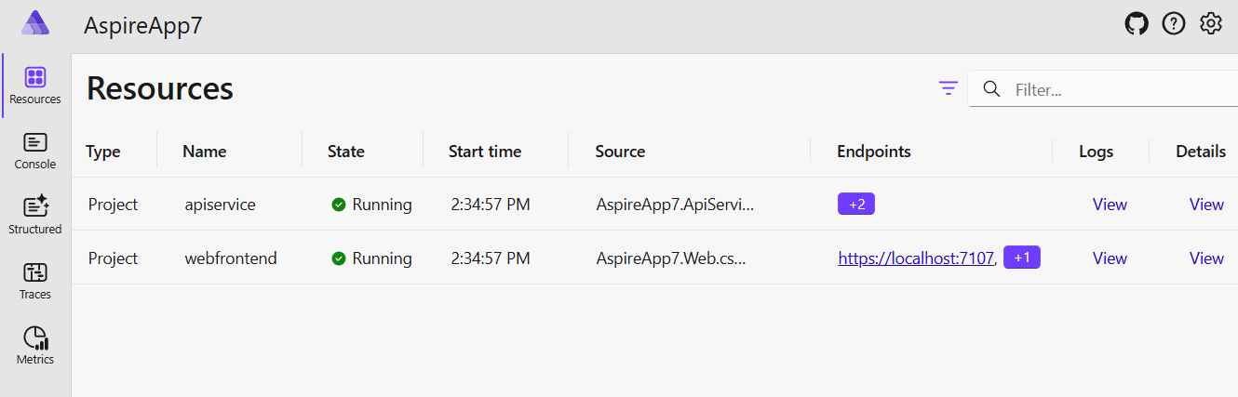
Après
Notes:
And what I get from that is a new project inside of Visual Studio or VS Code that allows me to add those projects and configure that program.cs file inside of the IDE I can also see that I have a new app host startup project and when I run it not only will it look to build and compile and run any of the projects or dependencies in the program.cs but it will also start a .NET Aspire dashboard that has a new tab on it called resources. and these resources are what are being defined specifically inside of that distributed application and here we can see that API service and that web front end and I can easily click in to see logs details and points.

Slide 31
DÉMO
.NET Aspire - Orchestration
Notes:
So, let's go ahead and add orchestration to this application.

Slide 32
Q&R
.NET Aspire - Orchestration
Notes:
So, let's go ahead and add orchestration to this application.

Slide 33
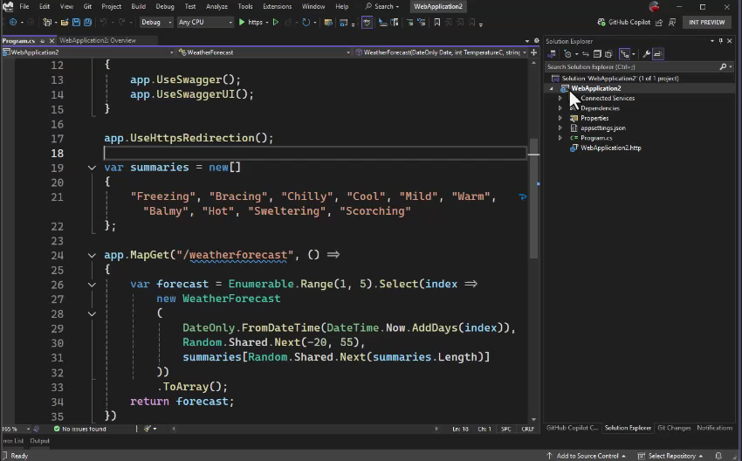
Outils Visual Studio pour .NET Aspire
Notes:
While you can manually add in the smart service defaults and configure orchestration with the App Host, if you are using Visual Studio 2022 there is great tooling support that will do it all for you automatically.

Slide 34
Une pile prête pour le cloud pour créer des applications distribuées observables, prêtes pour la production
Paramètres par défaut intelligents
Tableau de bord du développeur
Orchestration
Découverte de services
Composantes
Déploiement
Notes:
With orchestration, the .NET Aspire app host knows what to start up but we can also configure it so it knows about project dependencies, and it can enable applications to automatically discover each other so we don't have to use hard coded strings.

Slide 35
Avant
{
"Logging": {
"LogLevel": {
"Default": "Information",
"Microsoft.AspNetCore": "Warning"
}
},
"AllowedHosts": "*",
"ProductEndpoint": "http://localhost:5228",
"ProductEndpointHttps": "https://localhost:7130"
}
builder.Services.AddHttpClient<ProductService>(c =>
{
var url = builder.Configuration["ProductEndpoint"] ?? throw new
InvalidOperationException("ProductEndpoint is not set");
c.BaseAddress = new(url);
});
Notes:
And what I mean by that is that traditionally we would use connection strings this is a pretty standard practice inside of our development to define an endpoint in this case with a specific address. And then when we deploy our application we would update this endpoint in our back end wherever we're have it deployed with the actual production endpoint. And then in our application we would use our configuration to grab the specific endpoint out. As a developer though we have to configure our application with to configure our back end and of course we need to make sure that we are always adding and updating these connection strings as we develop. It sure would be nice if we could automatically have our applications discover each other if they depend on each other

Slide 36
Découverte de services
var builder = DistributedApplication.CreateBuilder(args);
var apiService = builder.AddProject<Projects.ApiService>("apiservice");
builder.AddProject<Projects.Web>("webfrontend")
.WithReference(apiService);
builder.Build().Run();
builder.Services.AddHttpClient<WeatherApiClient>(client =>
{
client.BaseAddress = new("https+http://apiservice");
});
Notes:
What we can do is instead of just adding each of our projects to the builder of our distributed application we can actually have the projects reference each other. In this case when I add a project it is returning a resource that I can then add as a reference to other projects so here our web front end is using our API service. And I want to make a special call out here which is that the API service and the web front end have these strings defined and these are specific keys that we can use later as part of service discovery. If we take a look below we have our service that we're adding an HTTP client on and in this case we're setting our base address to be both HTTPS plus HTTP and we're using that API service string that .NET Aspire service discovery will automatically resolve for us when we run our application.

Slide 37
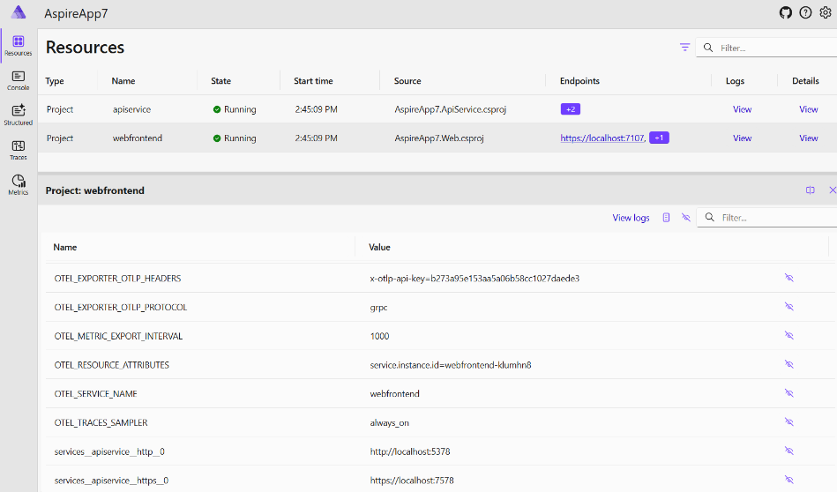
Il y a encore des chaînes de connexion😀
Notes:
Now this doesn't mean that we're getting rid of connection strings. In fact, a connection string is generated for us by the .NET Aspire App host and it is automatically set up when we run our application. This means that if we have our connection strings configured we can still set them on our back end when we have them deployed.

Slide 38
DÉMO
.NET Aspire - Découverte de services
Notes:
Let's take our application that is orchestrated and let's go ahead and type in some service discovery and update our connection strings today to take advantage of it.

Slide 39
Q&R
.NET Aspire - Découverte de services
Notes:
Let's take our application that is orchestrated and let's go ahead and type in some service discovery and update our connection strings today to take advantage of it.

Slide 40
A cloud ready stack for building observable, production ready, distributed applications
Smart Defaults
Developer Dashboard
Orchestration
Service Discovery
Components
Deployment
Notes:
Now as we mentioned earlier our application is small today but it is using things such as a database but as our application grows we're going to start to integrate in more services and additional dependencies that we may want to use and that's where .NET Aspire components come in.

Slide 41
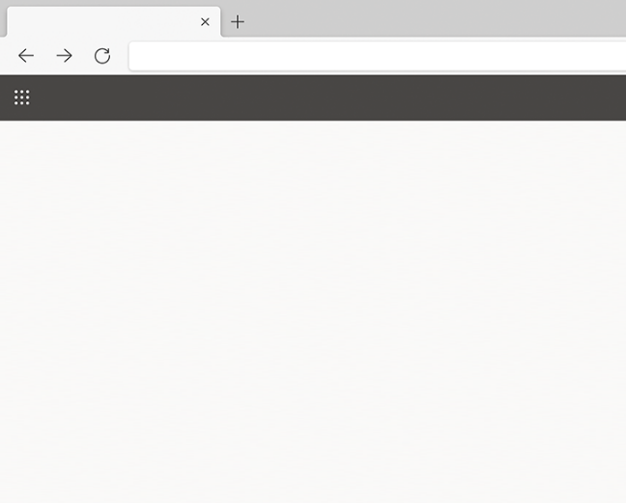

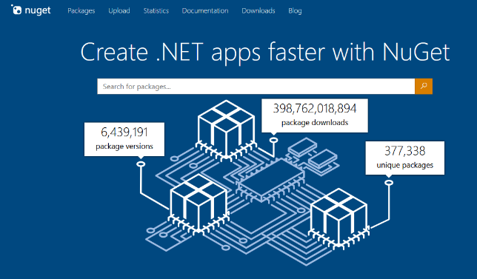
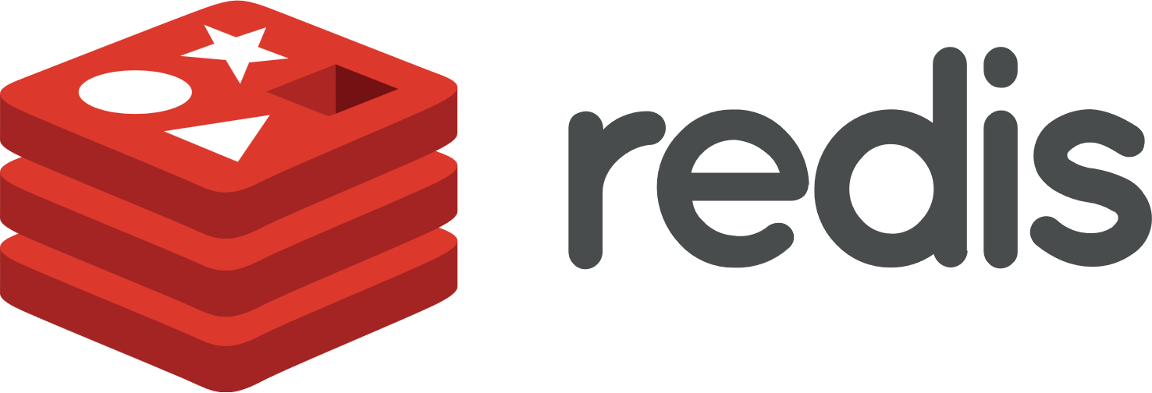

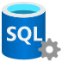







Composants
Nuget Gallery | Home
https://www.nuget.org
Notes:
Done an Aspire component or a curated list of optimized libraries that are preconfigured to easily integrate into .NET Aspire app host projects and additionally into .NET projects directly that are being orchestrated with Aspire. So, this thing means things like SQL databases, Cosmos DB Azure integrations, Redis Cache, messaging, and a lot more and all of these are available open source and directly on NuGet. In addition to libraries from Microsoft and for Azure there's great integrations into other ecosystems as well such as AWS.

Slide 42
L'image du conteneur sera automatiquement extraite et démarrée dans Docker ou Podman !
Orchestration des composants
var builder = DistributedApplication.CreateBuilder(args); var Postges = builder.AddPostgres("Postges").WithPgAdmin(); var db = Postges.AddDatabase("db");
var cache = builder.AddRedis("cache");
var apiService = builder.AddProject<Projects.ApiService>("apiservice")
.WithReference(db);
builder.AddProject<Projects.Web>("webfrontend")
.WithReference(apiService)
.WithReference(cache);
builder.Build().Run();
Notes:
So how is this different than just adding the library directly? Well, the first thing is that when you add in the component to the app host it gives you single line integrations to easily integrate those libraries. So, for example, here I'm not only adding a Postges database but I'm also adding a Postges admin as well and on top of that I'm adding Redis cache into it and configuring my back end and my front end to automatically use these new dependencies which will go through the service discovery phase.
Now when I run my application .NET Aspire will automatically pull down the container images or any other dependencies required and automatically start them inside of docker or podman. This is a huge save of time where developers getting up and running on their local machine.

Slide 43
Intégration des composants
var builder = WebApplication.CreateBuilder(args);
builder.AddServiceDefaults();
builder.AddRedisOutputCache("cache");
builder.Services.AddRazorComponents()
.AddInteractiveServerComponents();
var app = builder.Build();
app.UseOutputCache();
app.MapRazorComponents<App>()
.AddInteractiveServerRenderMode();
app.MapDefaultEndpoints();
app.Run();
Configure le service avec ces tentatives, contrôles de santé correspondants, journalisation et télémétrie !!!!
Notes:
Now on top of that there's another package that you integrate directly into your applications so if you want to add caching for example into your back end or your front end you may add in the output caching component into your Blazor application. Here that's what I've done and I've simply added a single line of code to say add Redis output cache with the same key that I configured earlier so it can go through service discovery. Now these components not just add Redis connectivity into your application but they also use smart defaults such as adding retries health checks logging and additional telemetry that we will be able to visualize into the dashboard.

Slide 44
DÉMO
.NET Aspire - Composants
Notes:
So let's go ahead and add Redis cache directly into this application.

Slide 45
Q&R
.NET Aspire - Composants
Notes:
So let's go ahead and add Redis cache directly into this application.

Slide 46
A cloud ready stack for building observable, production ready, distributed applications
Smart Defaults
Developer Dashboard
Orchestration
Service Discovery
Components
Deployment
Notes:
All right finally is the deployment phase of the application because .NET Aspire as I've shown so far gives us a world class development experience and really helps us locally on our machine get deep insights into our application comma but at some time we need to be able to deploy it..

Slide 47

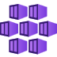

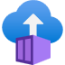



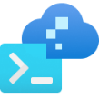





Intégrations et déploiement flexibles
Comme vous procédez aujourd’hui!
AWS CDK
Azure Dev CLI
Visual Studio
Notes:
So what are our options well the first thing is that you can continue to just deploy your application directly like you have been doing today. now it may mean that you need to add a few more connection strings or you may need to add in those dependencies into your deployment pipeline. But no matter where you're deploying your .NET applications today and whatever services you're using you can continue to deploy. In this case I may decide to integrate Azure Redis Cache and continue to deploy my application into App Service. Or I might decide that I want to take it further and I want to use things such as container apps to bundle up application article even further such as using Kubernetes services. But of course, you can deploy your application everywhere.
In addition to how you deploy today there's deep integrations for AWS and for Azure like we've seen with components but in additionally into the command line to help you get your services up and running. And of course it wouldn't be Visual Studio with a little right click publish. Visual Studio directly integrates into the Azure developer CLI to give you sort of an easy button to start to deploy your application. Visual Studio on Azure developer CLI can take your application and bundle it up automatically into containers and publish them to Azure Container Apps. Let's take a look and see what that looks like.

Slide 48
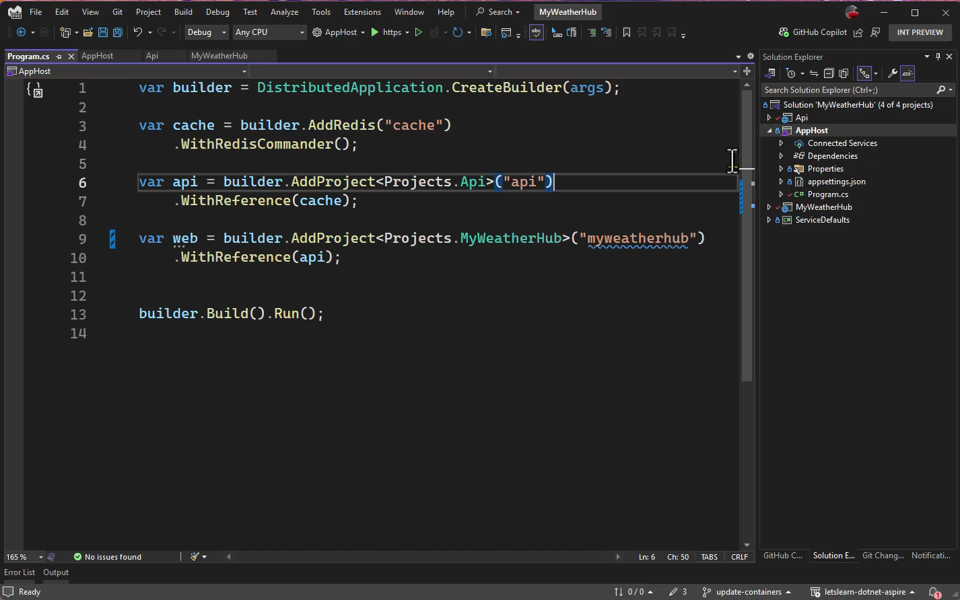
Notes:
Here inside of Visual Studio like I said you can simply right click and publish and as of today you have the option to automatically deploy to Azure container apps. Now what's happening here is that when we use .NET Aspires app host it generates a manifest, and that manifest can be used by different tools such as the Azure developer CLI to be able to take everything about my application and automatically configure in this case Azure Container Apps and all the adjacent services. So Visual Studio handles this all for me automatically and I can easily integrate it into my CI and CD pipeline. And while this is the easy mode especially if I'm wanting to see my application run really quick in a real environment as I previously mentioned the .NET Aspire project can generate and manifest and it can be used in other tools just as Aspir8 which is an open-source tool that enables you to take your Aspire application and put it into Kubernetes services. But with all that being said this is just one option for you and you can continue to deploy your application today as you always have.

Slide 49
Une pile prête pour le cloud pour créer des applications distribuées observables, prêtes pour la production
Paramètres par défaut intelligents
Tableau de bord du développeur
Orchestration
Découverte de services
Composantes
Déploiement
Notes:
So these are the major features of .NET Aspire that we've now integrated directly into this application, and we're all set up to deploy our application. But there's a lot more to .NET Aspire including deep integration into tooling templates and a lot more as you start to build out your application.

Slide 50

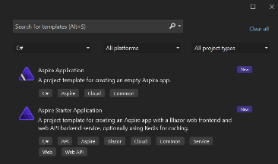
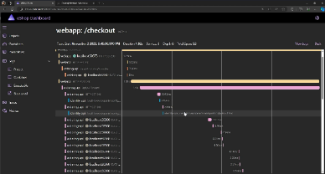
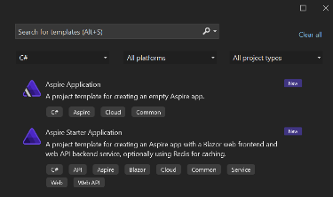
Facile à débuter
Facile à construire
Facile à déployer
SDK
Modèles
Composants
Découverte de services
Tableau de bord du développeur
Journaux, métriques, traces distribuées
Commande “run” unique
Topologie d'application en C#
Déploiement cloud
Notes:
What's great is that .NET Aspire makes it super easy to get started with those templates that come with the SDK workload, we've seen it easily integrate into our local development experience and give us deep insights and we also saw how easy it is to deploy our application and orchestrate it with C# topology

Slide 51
DÉMO
.NET Aspire – Projet de démarrage (Starter Project)
Notes:
Today, we showed how to integrate .NET Aspire into an existing app and all of the features, but what if you are starting a new project! Let’s take a look at the starter project.

Slide 52
Q&R
.NET Aspire – Projet de démarrage (Starter Project)
Notes:
Today, we showed how to integrate .NET Aspire into an existing app and all of the features, but what if you are starting a new project! Let’s take a look at the starter project.

Slide 53
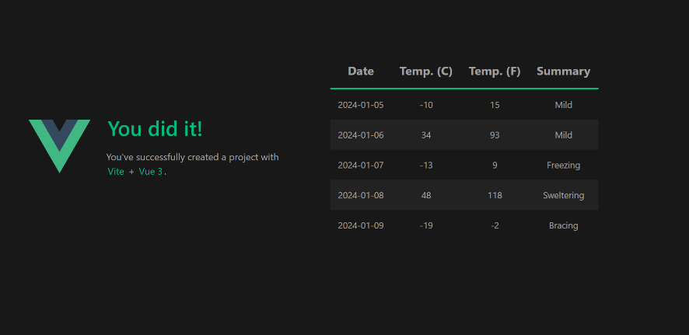
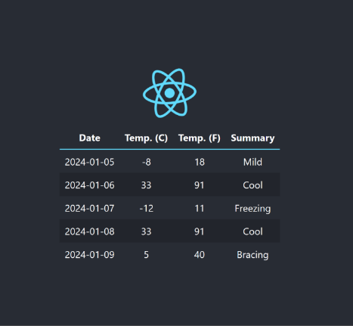
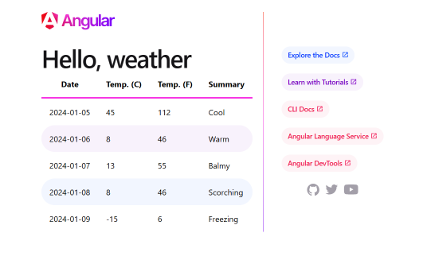
Ajouter à n'importe quelle application
Notes:
Now another thing I want to talk about really quick before we wrap this up is that I mentioned you can integrate other types of applications in to .NET Aspire systems. There's two specific ways of doing this one of just using open telemetry in your existing let's say JavaScript application and using the standalone Aspire dashboard. But additionally, you can integrate in node applications in to the app host to automatically run your node front end with your .NET backends.

Slide 54
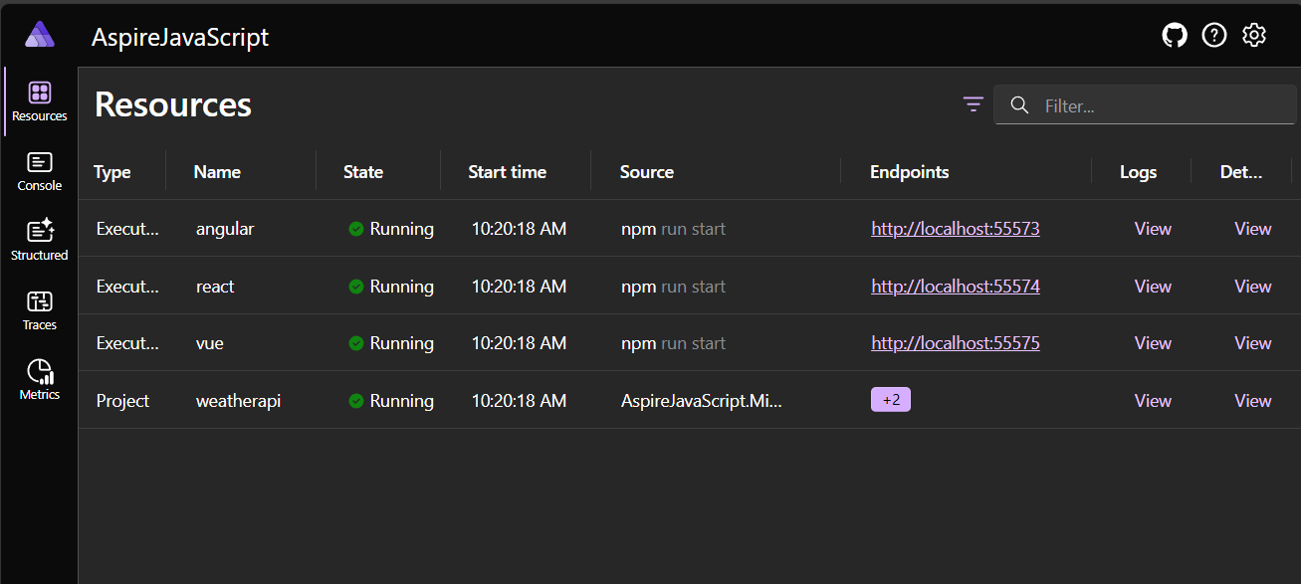
.NET Aspire pour tous!
builder.AddNpmApp("angular",
"../AspireJavaScript.Angular")
.WithReference(apiService)
.WithHttpEndpoint(env: "PORT")
.WithExternalHttpEndpoints()
.PublishAsDockerFile();
Notes:
And when you do that you'll see not only in the .NET Aspire dashboard your .NET API for example in this case running but it will also show you all of your other resources running which happened to be in this case node applications.

Slide 55
Une pile prête pour le cloud pour créer des applications distribuées observables, prêtes pour la production
Paramètres par défaut intelligents
Tableau de bord du développeur
Orchestration
Découverte de services
Composantes
Déploiement
Notes:
So these are the major features of .NET Aspire that we've now integrated directly into this application, and we're all set up to deploy our application. But there's a lot more to .NET Aspire including deep integration into tooling templates and a lot more as you start to build out your application.

Slide 56
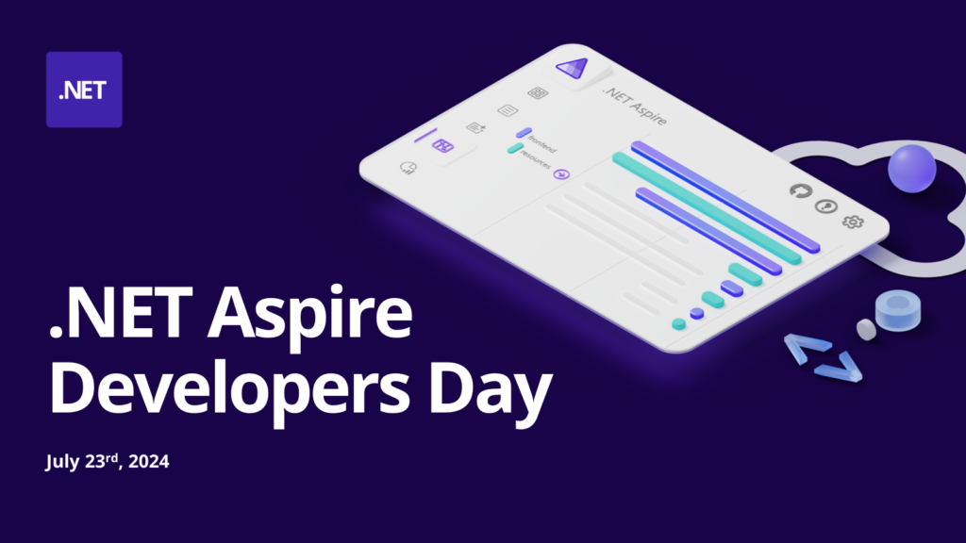
aka.ms/dotnetAspireDevDay

Slide 57

Ressources d'apprentissage
Vidéos .NET Aspire
aka.ms/letslearn/dotnet/aspire
aka.ms/aspire/videos
Documentation
Engagez-vous avec l'équipe
sur GitHub
aka.ms/dotnet-aspire
github.com/dotnet/aspire
Nom du présentateur
Nom de l'entreprise
/@Account
/@Account
Notes:
There you have it from start to finish no matter what size or scale your application you can easily get observability resiliency scalability and manageability and so much more by integrating ..NET Aspire into your application. On top of all of that we get a super productivity boost .NET developers in our local development day-to-day.

